Slide 1
Google Docs
Phishing Attack
by Wasfi Momen
Source:
https://www.theverge.com/2017/5/3/15534768/google-docs-phishing-attack-share-this-document-with-you-spam

Slide 2
Spearphishing vs Phishing

Slide 3
Article Rundown
Reported by the Verge, but initial source is a post on Reddit: https://goo.gl/ToBb5n
Email comes from someone on your contacts list. Runs javascript to execute.
Uses a real Google sign-on link to ask access to user's Gmail.
Name of the app is Google Docs. As in, "Google Docs would like to have your access".
Information of the app developer is hidden in a popup.
Issue was discovered early on May 3rd, 2017 with a fix by Google 5:17pm.

Slide 4
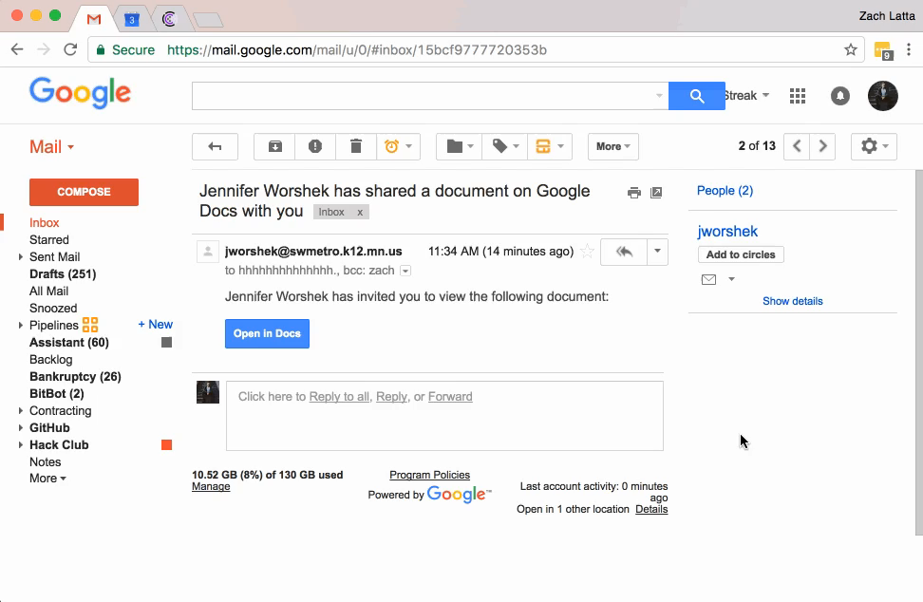

Slide 5
Techniques
Replicates the recognizable Google brand to trick users.
Takes advantage of Google's design choice to not show the app dev email.
Authorizes through Google's own Oauth management.
Spreads by sending spam to all emails in user's contact list.

Slide 6
Impact
According to Google, no reports of any data stolen except emails.
Only 0.1% of users affected, but at Google's scale that is 1 million users.
Google had to shut down Oauth client for a while.

Slide 7
Recovery
Knowledge is power. Users reported and didn't authorize the app once they knew via social media.
Taking responsibility. Google issued warnings on social media 15 minutes before the Verge article was published. Fix was completed at 5:17 p.m. that protected users "through a combination of automatic and manual actions".
Further action. Google points users the the Google Security Checkup website to protect themselves from further attacks.

Slide 8
Questions
Did Google do enough to protect its users from these sophisticated phishing attacks?
How useful is social media in notifying users of cyberattacks? What about in differing levels of sophistication (Phishing email vs Meltdown/Spectre)?
Is Oauth still useful as an access control manager? Or does it trade off too much security for accessibility?

